Slide 1

Department Of Electronics and Telecommunication Engineering
A Presentation on :
Wheelchair management system using IOT.
IN THE PARTIAL FULFILLMENT FOR THE AWARD OF THE DEGREE OF
BACHELOR OF ENGINEERING IN ELECTRONICS AND
TELECOMMUNICATION
Presented By:
Amey Dhananjay Vazurkar
Rehan Rahimatullah Sayyed
Anushka Siddeshwar Danke
Guided By: Mrs.Geeta.D.Salunke

Slide 2
Contents
Introduction
Literature Survey
Problem Statement
Objectives
Block Diagram
Methodology
Circuit Diagram
Components Required
Project Photo
Future Scope
Reference

Slide 3
Introduction
• We know that the needs of many people with disabilities can be overcome with power wheelchair.
• Though we have evolved in the field of health care and technology, but we are still not good enough to solve difficulties of this sector of population.
• This project is related to an android phone controlled wheel chair along with an alternative use of manual joystick.
• The main objective of this project is to felicitate and increase the movement of people who are handicapped and the ones who are not able to move freely.
• Therefore, we are coming up with a design of wheelchair which will be an asset for medical department.

Slide 4
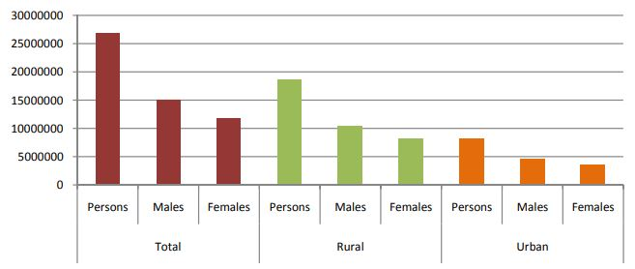
Literature survey
International Research Journal of Engineering and Technology (IRJET) e-ISSN: 2395 -0056 Volume: 04 Issue: 05 | May -2017 www.irjet.net p-ISSN: 2395-0072
SUMMARY OF LITERATURE SURVEY:

Slide 5
Problem Statement
Till this date there were only manual wheelchair with manual movements and wasn’t so sufficient for the patient.
The wheelchair was not having a monitoring system to monitor the health of the patient.
The automatic wheelchair system was also less efficient with less monitoring tools.
The Automatic wheelchair including a joystick was not properly monitored and patient having hand disability couldn’t use it effectively.
Hence, Automatic Wheelchair management system IOT features for Automatic movement of chair with monitoring tools to monitor a live status of the patient health.

Slide 6
objectives
The main agenda of this project is to enable a disabled person to move with less difficulty.
Due to exponential growth of technology with time, it is the need of the hour to provide easily operated machines.
The various modes of control will allow to move the chair with less human intervention.

Slide 7
Block diagram
WIFI
Android phone
Wheelchair
With buzzer for emergency
Ardiuno
(Atmega 328)
Emergency
Switch
Health monitoring sensor
IR sensor

Slide 8
methodology
In the propose methodology the controlling of the wheelchair is through an android phone application which is connecting via Wi-Fi module.
A manual joystick is fixed on the hands of the chair.
These two will decrease the dependency of user on another person.
We have also equipped our chair with ultrasonic sensors which will help to avoid accidents.
Sensors will respond to the nearing obstacle and eventually commands will be forwarded to the microcontroller(ATMega328) enabling.
This system also includes a health monitoring system which monitors health of the user.

Slide 9
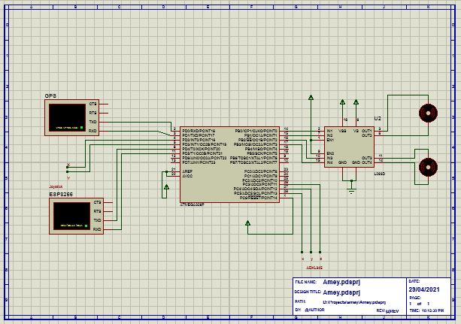
CIRCUIT DIAGRAM

Slide 10
COMPONENTS REQUIRED
Atmega 328 IC (Controller)
LM-35 Temperature Sensor
KG011 Heartbeat Sensor
HC-SR04 Ultrasonic Sensor Module
SIM-28 GPS(Global Positioning System)
Thingspeak Cloud
Resistors
Switch

Slide 11
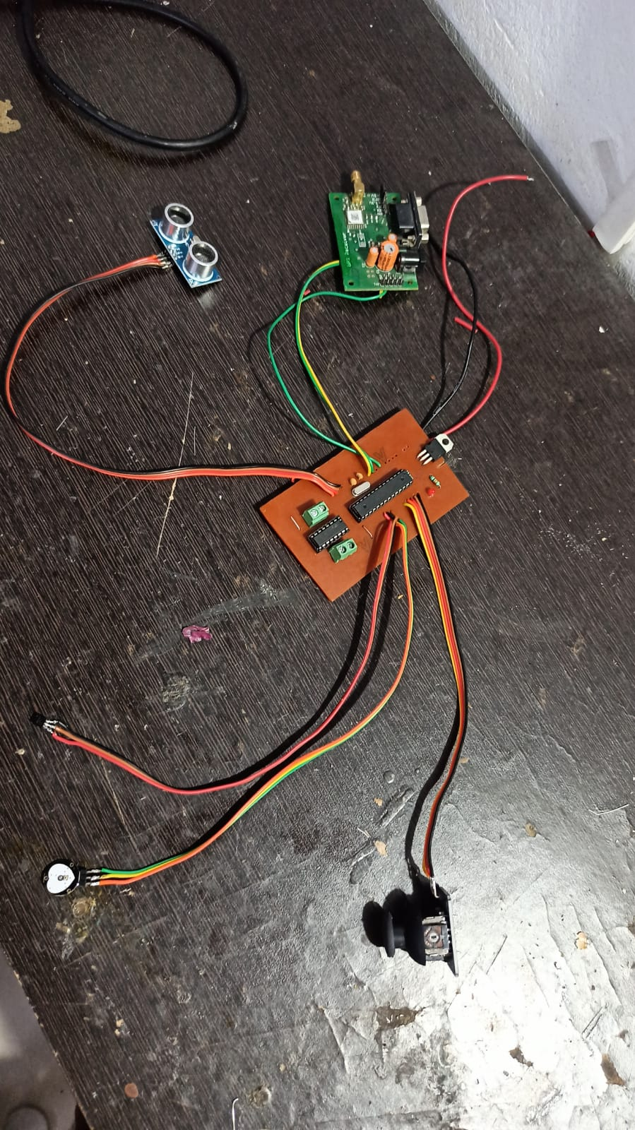
Project photo

Slide 12
Future scope
We can install solar power panel for charging of wheel chair
We can implement voice controlling system for movement of wheel chair
We can additional monitoring sensor like Blood pressure sensor, ECG Monitor, etc.

Slide 13
References
Vasundhara, G. Posugade, Komal K. Shedge, Chaitali S.Tikhe (2012) “Touch Screen Based Wheelchair System”, International Journal Of Engineering Research and Applications, Volume 2, Issue 2, MarApr-2012.
Archana Hule, Rekha Bandage, Pratik Shah, Rashmi Mahajan (2015) “android based application for wireless control of wheelchair”, International journal of research in Engineering and Technology (IJRET), Vol-4, Issue- Apr, 2015.
Jayesh, K.Kokate, A.M.Agarkar (2014) “Voice operated wheelchair”, International Journal of research in engineering and technology, Volume 3,Issue 2, Feb-2014.

Slide 14
Thank You

